Slide 1
Pressure
and
Moments

Slide 2

Pressure - In solids
If a force is applied over a smaller surface area you get a larger pressure.
Pressure can be calculated using the following equation:
Newtons
N
m²
Pascals or N/m²

Slide 3
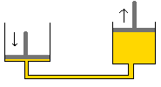
Pressure - In liquids
 | Pressure increases with depth.
 | Pressure acts equally in all directions.
 | Pressure is transmitted through liquids.
All hydraulics systems work because the pressure is the same throughout the system.

Slide 4
Moments
Moments make things turn or rotate.
They are caused by forces but are not forces themselves.
The moment will be bigger if:
The force causing the turning effect is bigger.
The force is further from the pivot.

Slide 5
Calculating the size of a moment
Moment = Force x Distance
Newtons
N
m
Nm

Slide 6
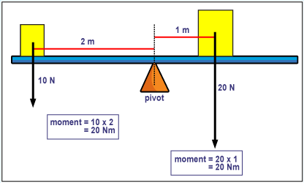
BALANCED
Net moment is zero
Anti-clockwise Moment = Clockwise Moment

